Slide 1
A Presentation On Campus Management System
Guided by:
Miss. Shalini Kumari. Technical trainer.
Presented By:
Miss. Khushbu Bandewar
Miss. Ankita Dohale
Java Full-Stack Development
EduBridge

Slide 2
Content
Introduction
Motivation
Objectives
Problem Definition
Software Requirement
Output
Advantages
Conclusion
Future Scope

Slide 3
Introduction
This Placement Management System is provides information about jobs for beginner and experienced to related there Profession.
This system is specially helpful for student or any people . Who need to information about jobs in any profession .

Slide 4
Motivation
To reduce manual work.
To maintain the various jobs activities related every Profession.

Slide 5
Objective
To study different Front-End and Back-End website.
To compare the proposed with existing system.
To develop a creative and logical thinking.
Improve the practical Knowledge In front-end and back-End.

Slide 6
Problem of definition
This website is create for helping of many student as well as experience people for applying jobs or knowing the information
In this system we Provide our services so first user can registration on that if they are already register then they can login and visit to our website.

Slide 7
Software Requirement
Front-end & Back-End :
HTML5
CSS
JavaScript.
JPA
Spring boot
IDE :
Sprint tool suite.

Slide 8
Description about Front-End
HTML5-
HTML5 is a markup language used for structuring and presenting content on the World Wide Web.
New features added in html5 is video & audio , vector graphics , web browser support ,ease to use.

Slide 9
Description about Front-End
CSS
Cascading Style Sheets (CSS) is a language that is used to illustrate the look, style, and format of a document written in any markup language. In simple words, it is used to style and organize the layout of Web pages.

Slide 10
Description about Front-End
MODULES OF CSS3
Background
Border
Animation
Text Effects
Media Queries
Selectors
Multi-column Layout

Slide 11
Description about Front-End
JAVASCRIPT
JavaScript is the programming language of HTML and the web. It makes web page dynamic .it is an interpreted programming language with object-oriented capabilities.

Slide 12
Description about Front-End
JPA(Java persistence API) -
The Java Persistence API (JPA) is a specification of Java. It is used to persist data between Java object and relational database. JPA acts as a bridge between object-oriented domain models and relational database systems.
As JPA is just a specification, it doesn't perform any operation by itself. It requires an implementation. So, ORM tools like Hibernate, TopLink and iBatis implements JPA specifications for data persistence.

Slide 13
Description about Front-End
SPRING BOOT-
Spring Boot provides a good platform for Java developers to develop a stand-alone and production-grade spring application that you can just run. You can get started with minimum configurations without the need for an entire Spring configuration setup.
Advantages
Spring Boot offers the following advantages to its developers
Easy to understand and develop spring applications
Increases productivity
Reduces the development time

Slide 14
Description about IDE
Sprint tool suite-
Spring Tool Suite is an IDE to develop Spring applications. It is an Eclipse-based development environment. It provides a ready-to-use environment to implement, run, deploy, and debug the application. It validates our application and provides quick fixes for the applications.

Slide 15
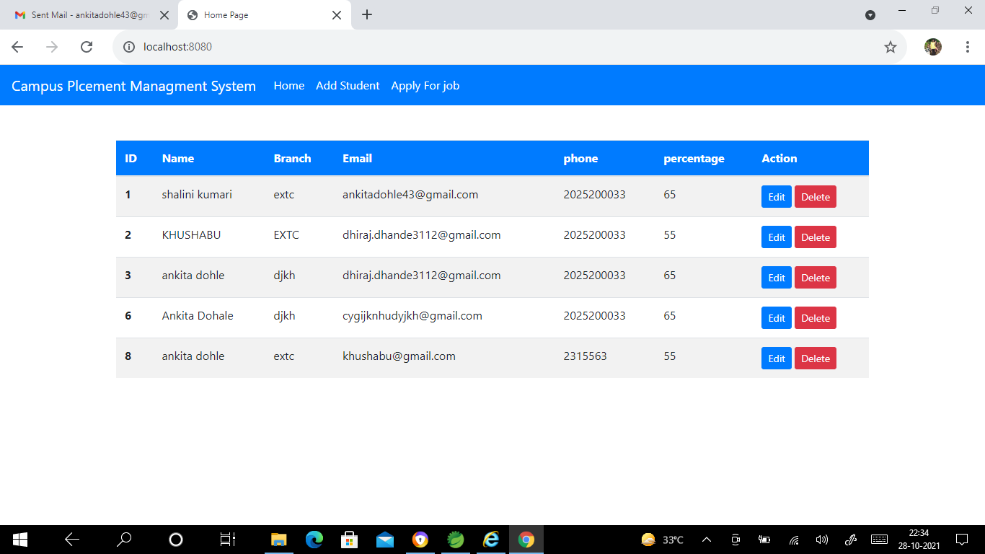
Outputs

Slide 16
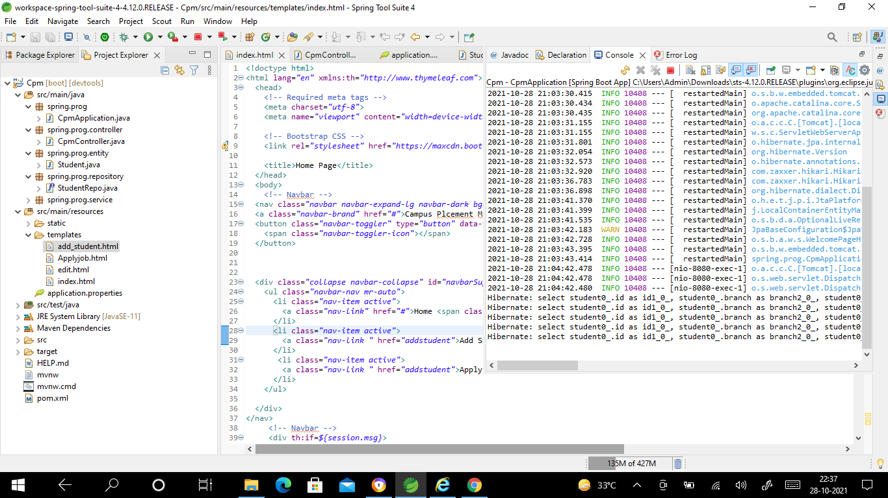
Outputs

Slide 17
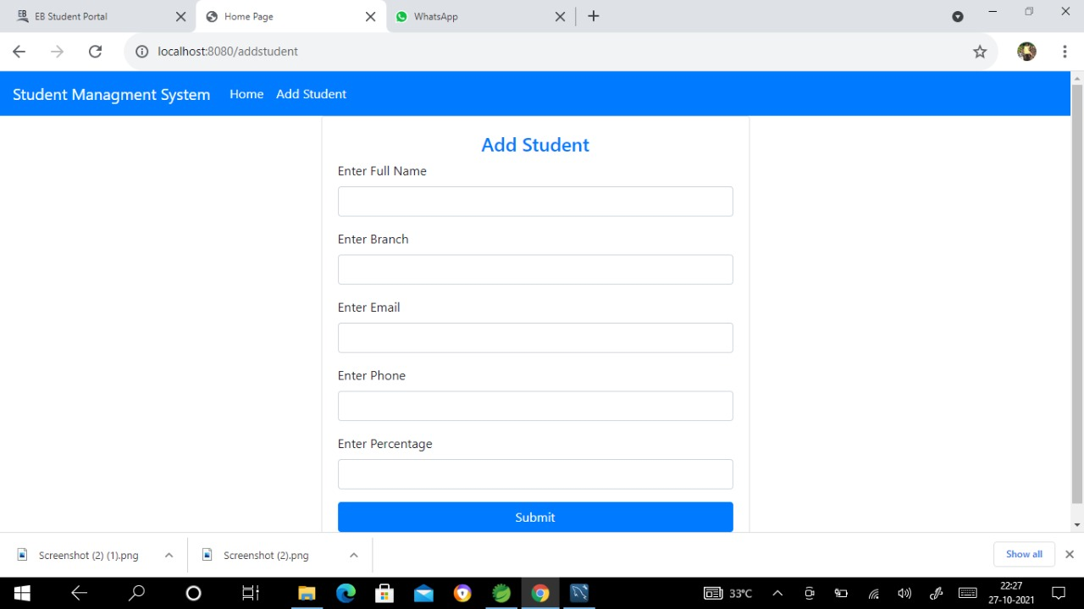
Outputs

Slide 18
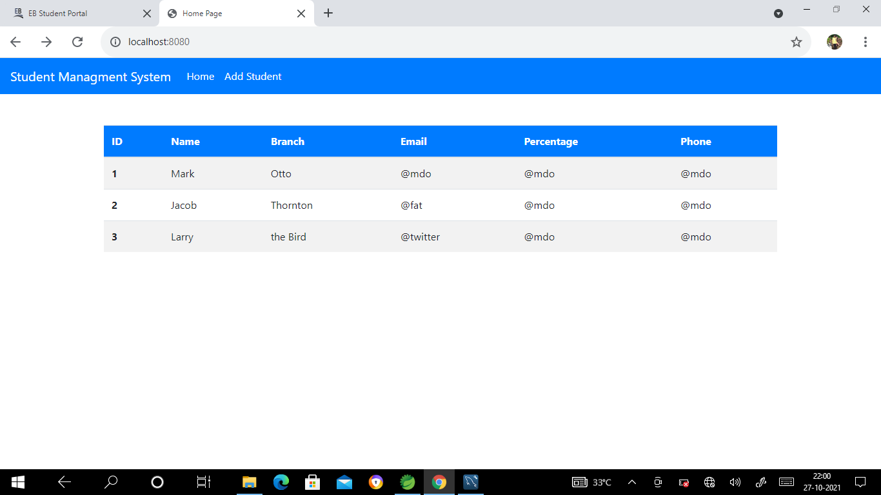
Outputs

Slide 19
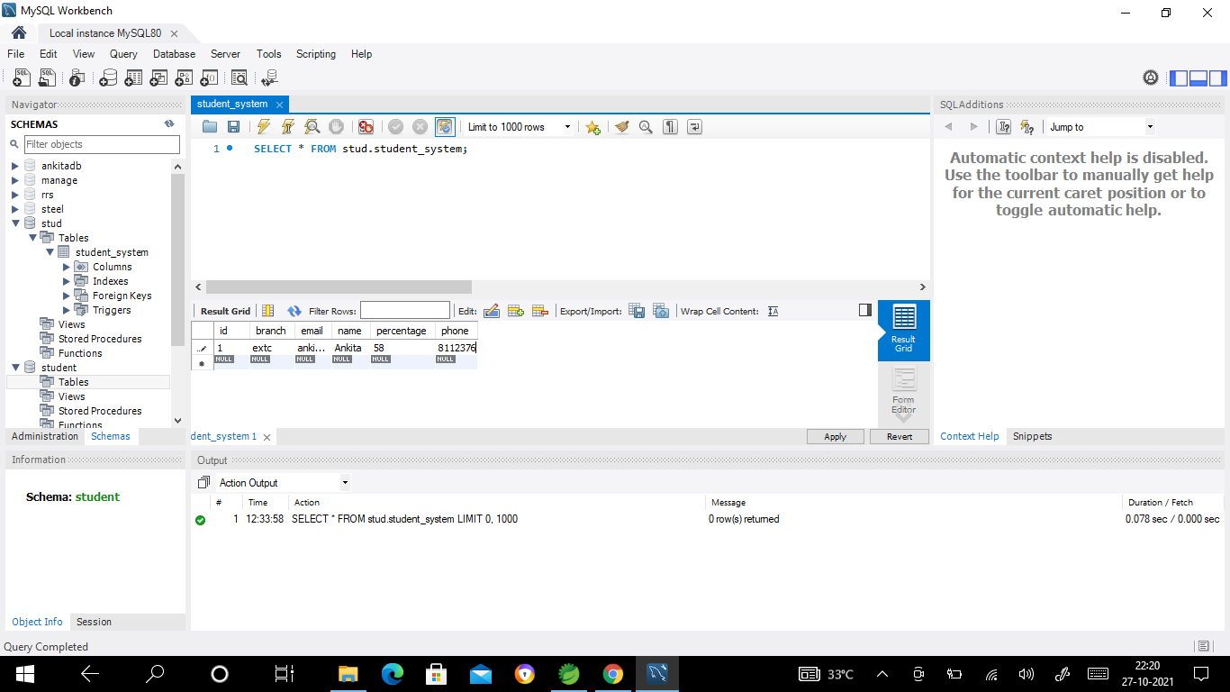
Outputs

Slide 20
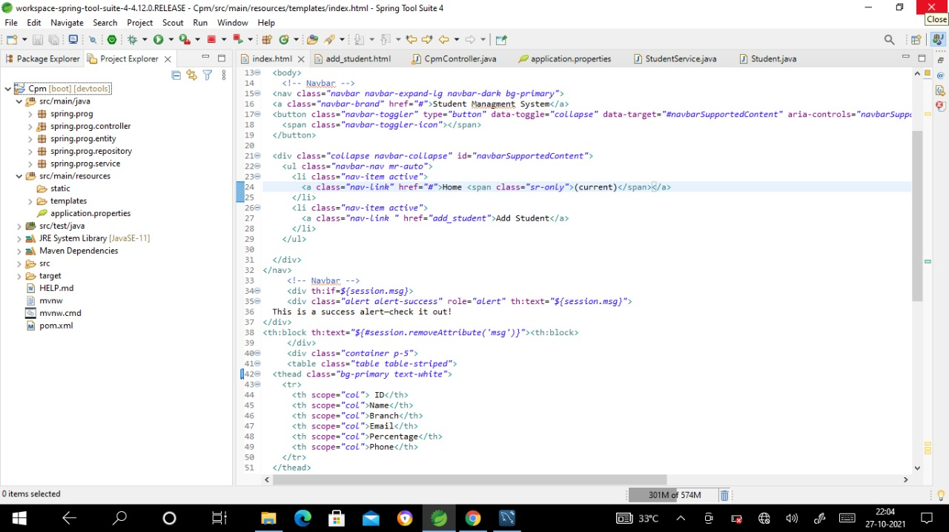
Outputs

Slide 21
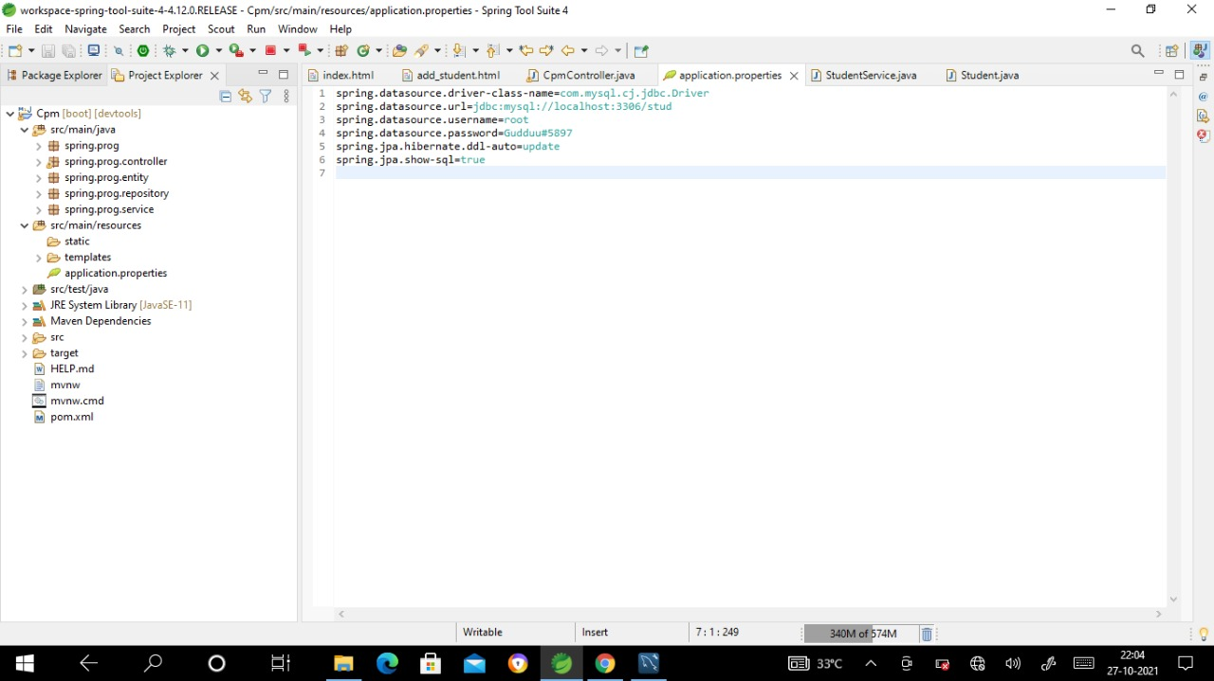
Outputs

Slide 22
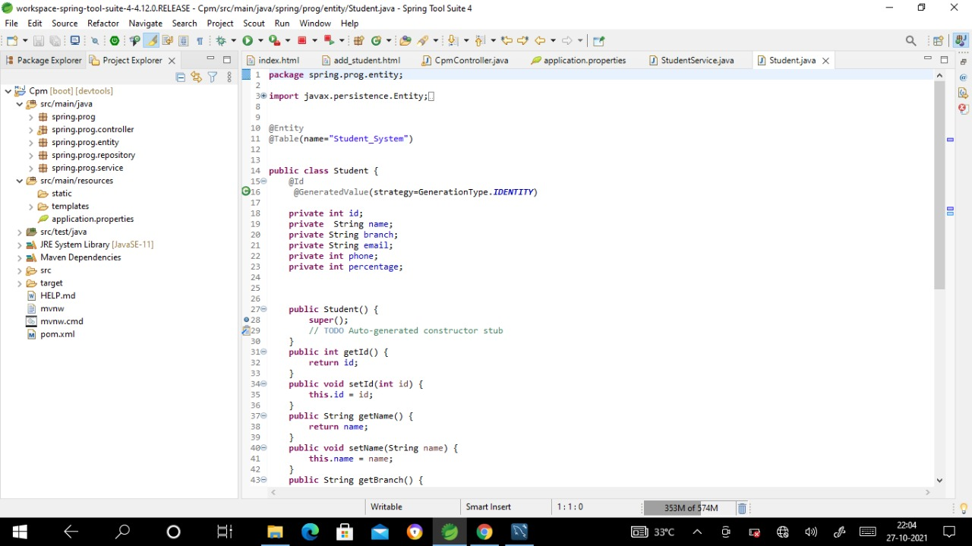
Outputs

Slide 23
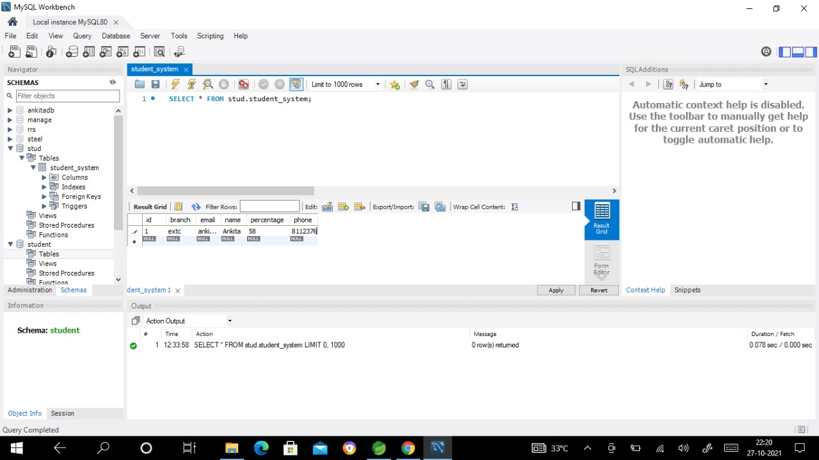
Outputs

Slide 24
Conclusion
This application provide all the necessary details or information about related to jobs for as a fresher(beginner) or a professional one they can easily find there requirements in this application.

Slide 25
Future Scope
Provide more Attractive look and many more features according to user requirements or needs.

